Slide 1
OPS-SAT Space Lab:
How the increased and more flexible onboard processing has changed the way we operate our satellite
David Evans
16/06/2021

Slide 2
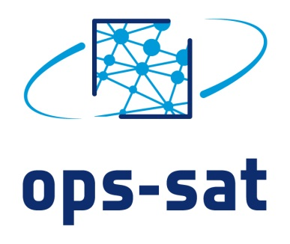
OPS-SAT Space Lab
3U cubesat launched by ESA on 18th Dec 2019
First nanosatellite to be directly owned by ESA and controlled by ESA/ESOC
The result of 7 years of development supported by GSTP and ESOC internal investment
OPS-SAT looks like an advanced ESA spacecraft to the ground. The uplink rate is four times higher than any ESA spacecraft; it employs never flown before communication protocols and implements new ESA patents.
At the centre of OPS-SAT is a high-performance control processor. This allows “normal” software (Linux, Java, Python…) to control the entire satellite: rotate, take pictures, classify them, compress them, send them to the ground, etc.
The processor integrates with a powerful FPGA that allows the FCT to reconfigure its firmware in space. Reconfigurable on-board software caused a revolution in space and this will be just as significant.
European industry and institutions can use the platform to rapidly test their software and firmware experiments in space at no cost and no bureaucracy. 175 experiments registered.
Recently closed OSIP campaign created another 55 experiments

Slide 3
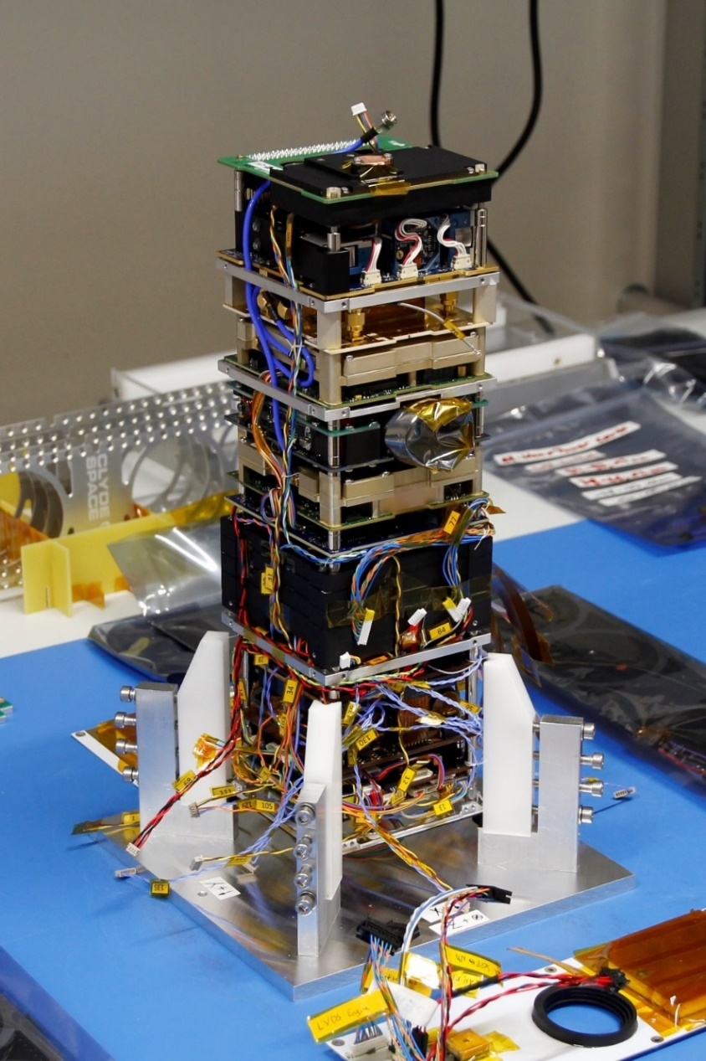
High level Space Segment view
A satellite within a satellite. Control can be swapped between the two and they monitor each other – providing the in-built robustness.
Fully equipped with
a full set of sensors and actuators including a camera, GPS, star tracker and reaction wheels
High speed X band and S band communication
Laser receiver
Software defined radio receiver
A 800 MHz processor with a reconfigurable FPGA at its heart

Slide 4
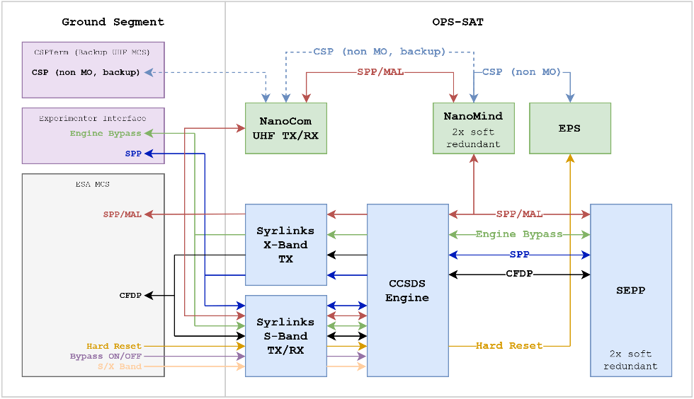
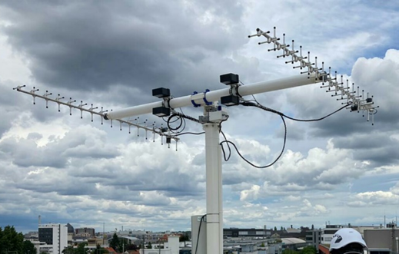
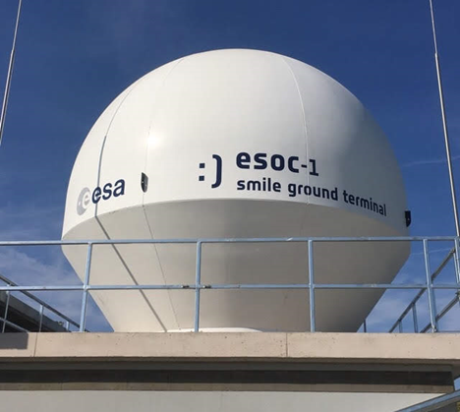
High Level Ground Segment view

Slide 5
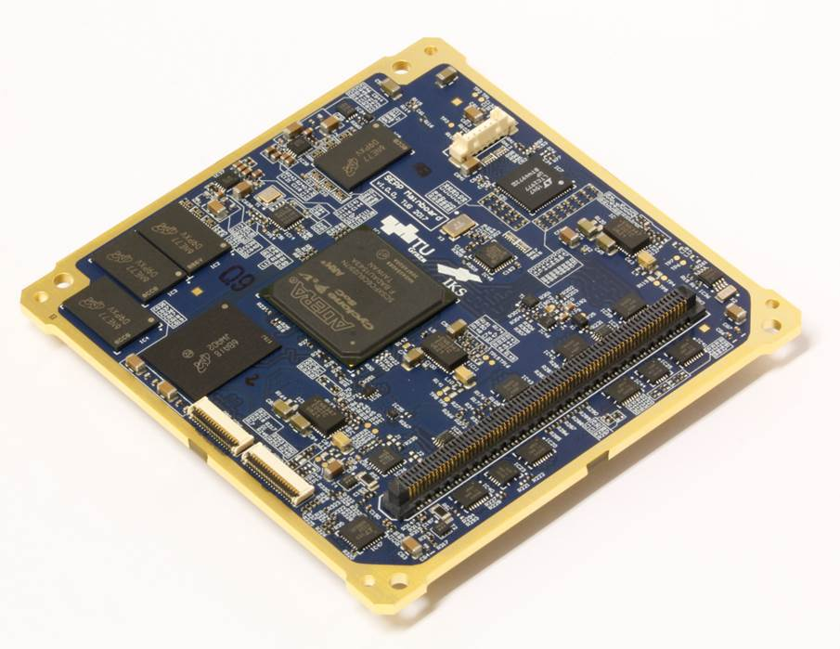
System Experimental Powerful Processor (SEPP)
2 x System on Modules in cold redundancy
Processor
Dual core 800 MHz ARM-9 processors
Altera Cyclone V FPGA, reconfigurable in flight, directly connected to S/X band transponder, SDR, OPT RX
Memory
1 GB DDR3 RAM (ECC)
Software
Linux, Java, NMF (see later)
TU Graz

Slide 6
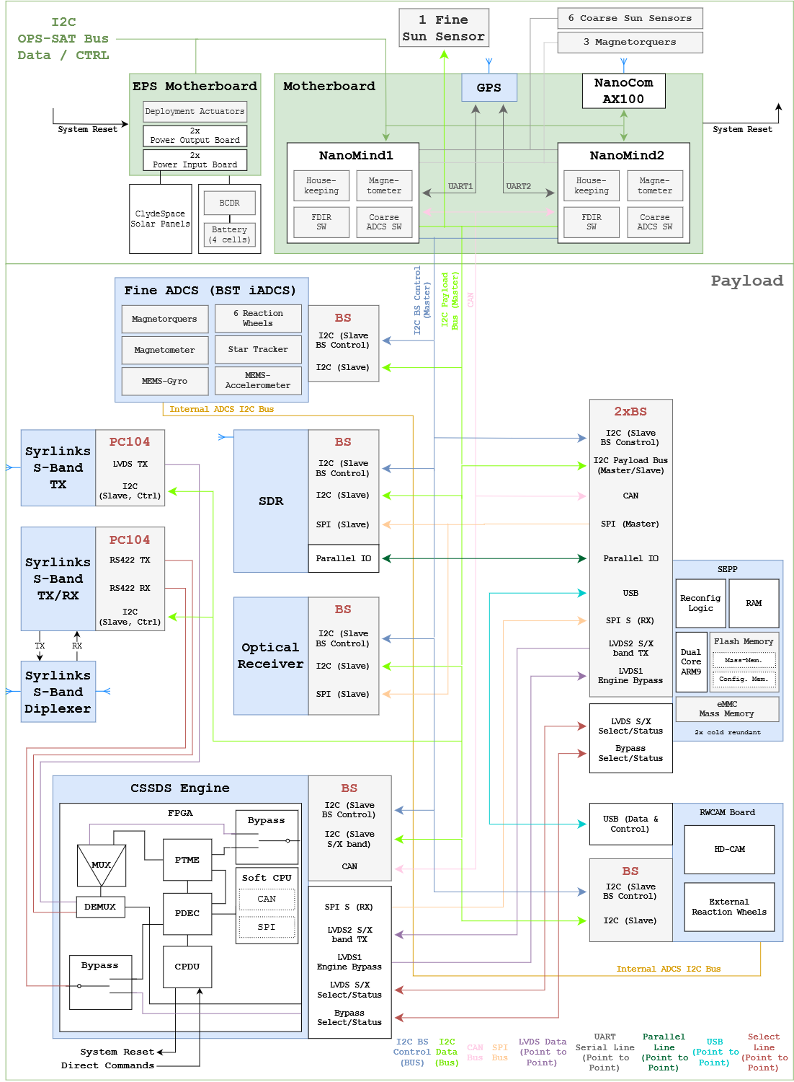

Slide 8
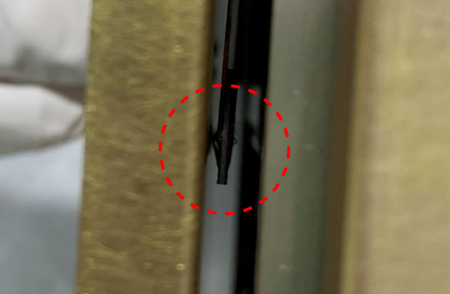
Problems before launch
Non-compliance wrt the deployer
➔ Almost did not fly
GPS failed the open field test
➔ Problem still exists in orbit
SEPP1 failed to boot intermittently after environmental testing
➔ SEPP2 experienced a problem in orbit maybe similar root cause
Last minute star tracker firmware update needed after integration
➔ Ingenious solution from the provider

Slide 9
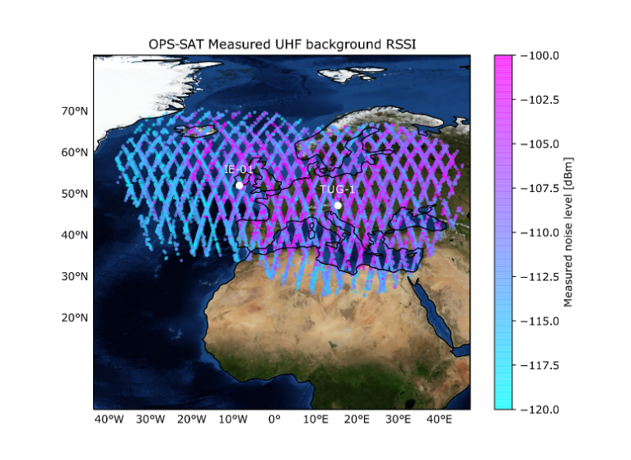
Problems in flight
Bad UHF communication
Timings
Background noise
OBSW issues prevented the S band TX on/off command working safely
Required complete OBSW update
S band RX noise level increased when S band TX was ON
➔10 dB increase in RX noise level
ESOC-1 High Power Amplifier failure
5-6 dB loss of uplink power

Slide 10
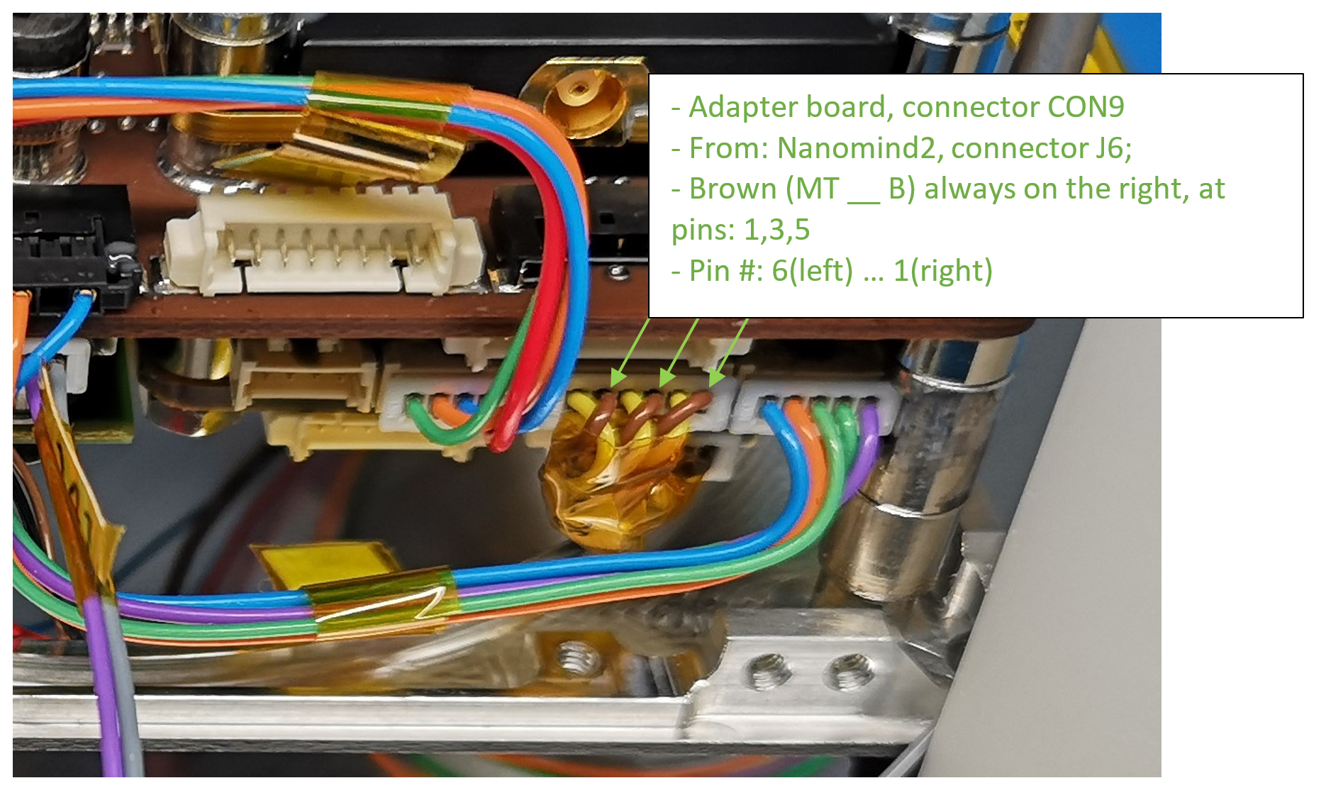
The night we almost lost the mission….

Slide 11
Overcoming the challenges using the SEPP
Use of SEPP as a commissioning tool (OPS-SAT FCT)
Commissioning with only 2 minutes uplink time per day ➔ impossible without SEPP centred approach
Use of SEPP as an OBSW update tool (Tom Mladenov/Ben Fischer)
➔ OBSW update took one week ➔ now two hours
Use of SEPP for TM data collection and POCKET+ compression (Vasundhara Shiradhonkar)
➔ Sniff the CAN bus and collect packets in files, compress with POCKET+ ➔ 10x increase in TM volume
Use of SEPP for picture compression using FAPEC (Dapcom)
Compression rates on 7 achieved with no visible difference ➔ Significant saving in bandwidth
SEPP modified to allow a SSH connection over TCP/IP all the way to the internet (Max Henkel)
➔ Many normal services become available e.g. file sync, encryption etc,

Slide 12
Going beyond the challenges using the SEPP
Implementation of Spacewire protocol in flight between the SEPP FPGA and CCSDS engine (Max Henkel)
➔ 10x increase in downlink rate, with further updates we could get another 10x on top
Modification of the FPGA to allow SDR to work out of the designed for frequency range (Max Henkel)
Originally designed for UHF, we are now measuring L1 i.e. GPS frequencies and discovering….
Implementation of GNU radio on-board for on-board signal processing (Tom Mladenov)
World first of acquisition and on-board decoding of search and resuce beacons. This will open the door to many exciting experiments using GNU Radio on SEPP (IoT, SAR, LoRa, etc).
Use of SEPP for on-board AI aided picture selection (Georges Labrèche)
➔ TensorFlowLite is being complemented by a whole suite of AI libraries ready for experimenters and operations to use…

Slide 13
Conclusions
The OPS-SAT LEOP and commissioning was a challenging time
Commissioning such a complex spacecraft while suffering from numerous communication problems required a complete rethink of the planned mission concept
The FCT had to think out of the box many times to make incremental improvements
Perhaps the most fundamental was that using “normal” software, running on a well connected, powerful payload computer, could be used to solve many of these problems and sometimes these solutions were even better than the original plan

Slide 14
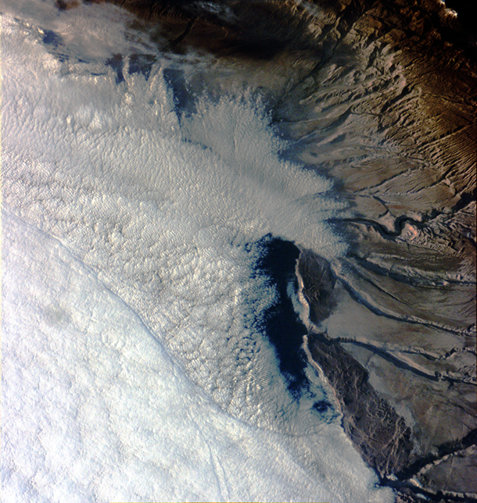
Thank you

