Slide 1
VOLT – External Slides

Slide 2
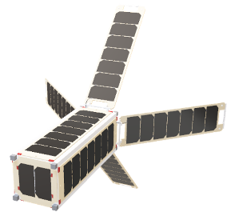
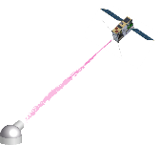
Craft Prospect Ltd. Overview
AI for Space
RESPONSIVE
OPERATIONS
QUANTUM
TECHNOLOGIES
Future Proof Cybersecurity
Intelligent Data Processing
MISSION
ARCHITECTURE
Modular Quantum/optical comms products
Autonomy and Assurance

Slide 3
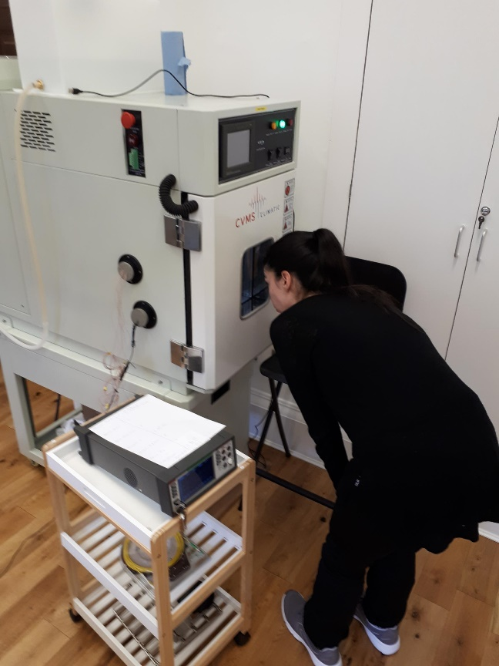
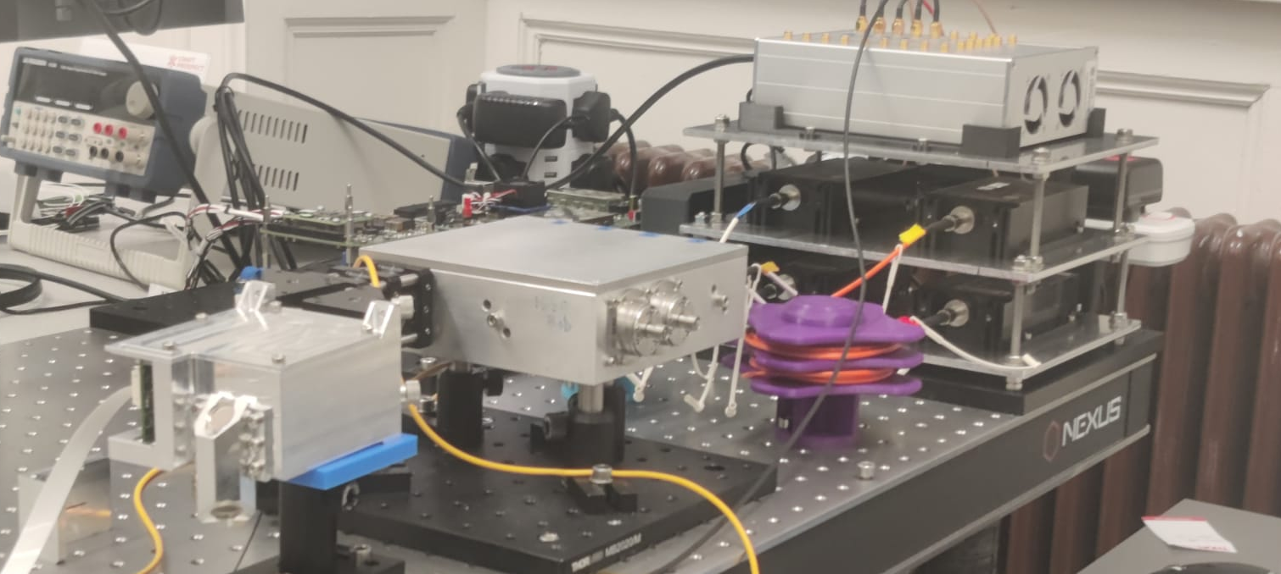
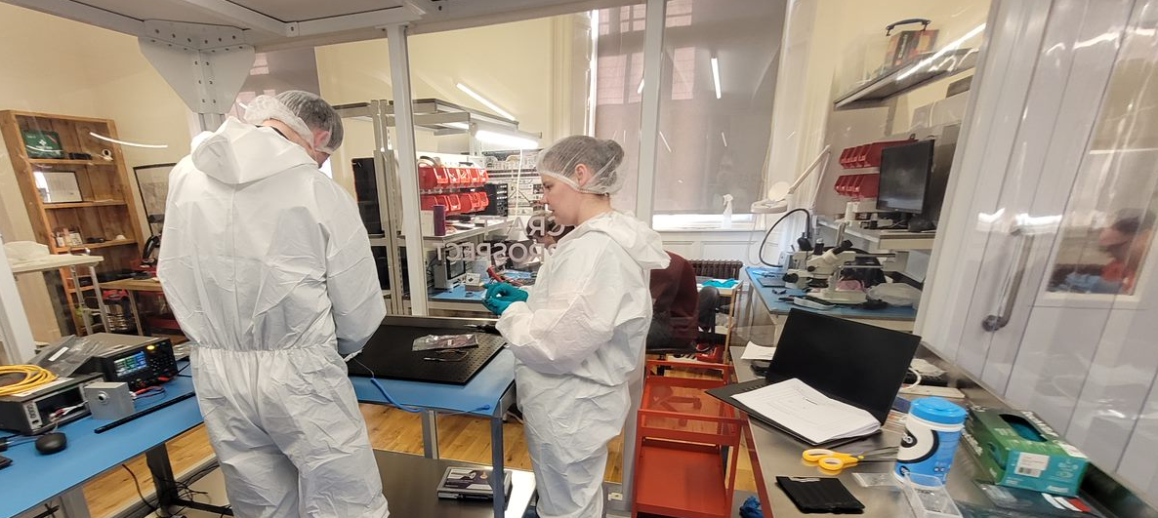
Craft Prospect Ltd. Facilities
Located in Glasgow Scotland within Fairfield building in Govan
Integration lab and workshop
ISO7 Cleanroom
ISO5 Laminar flow cabinet
Dedicated AI simulation and Quantum optics test benches
Rapid prototyping, 3D printing & CNC machine
Thermal ambient chamber
Miniature ESD shaker
Security-minded working
Cyber essentials plus
ISO9001 processes

Slide 4
VOLT Mission Objectives
Demonstrate end to end services using optical communications
Achieve TRL 9 for core quantum & onboard AI products
Build practical as-flown understanding of concept of operations
Integrate space segment with rapidly deployed Nomadic OGS
Demonstrate value add of autonomy/AI/ML systems

Slide 5
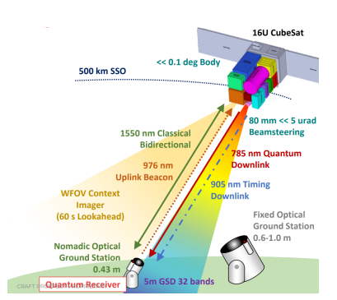
VOLT Mission Overview
Creation of an in-orbit experimenter platform for Earth Observation and Optical Communication
Free Space Optical Communications
O3K CCSDS Compatible Communications
1550nm Downlink, 1537nm Uplink
Reconfigurable FPGA for Optical Comms
Redundant fixed pointing auxiliary transmitter
Quantum Key Distribution
Quantum Random Number Generator
785 nm Downlink WCP
BB84 with Decoy States
ETSI Key Management
AQKDs Service Provided
Beam Steering Unit & Primary Telescope
80 mm bespoke Schmidt Cassegrain Telescope
Fine Pointing System, Accuracy <<5 μrad
905nm Downlink Beacon Channel
Designed for 976nm Uplink Beacon Reference
Earth Observation Sensor Package
32x Selectable Hyperspectral Bands (VNIR)
Wide Field of View Context Imager w/NN Backend
Feature Detection & Geolocation capabilities
Reconfigurable optical processing chain
High Performance Data Processing Unit
AI/ML Algorithms
Reconfigurable Autonomy Enabling Components
Ops-Sat Experiment Sandbox
Payloads of Opportunity
Entangled Photon Source
Additional Payloads TBC

Slide 6
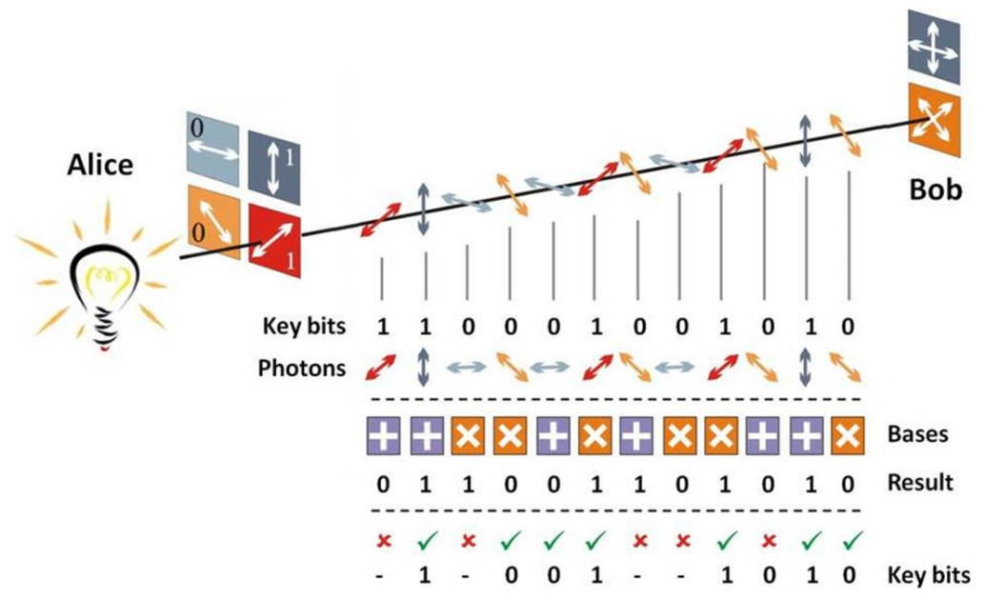
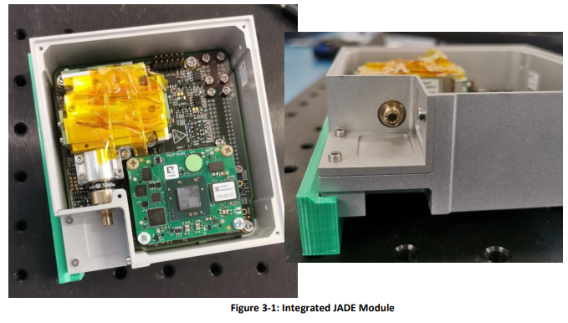
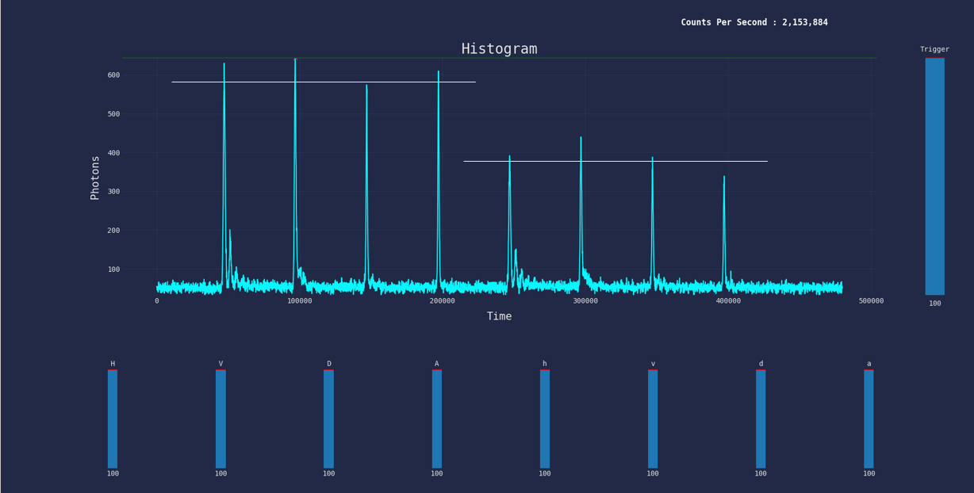
Quantum Key Distribution
Quantum Source and Receiver developed by Craft Prospect Ltd. with support from University of Strathclyde and University of Bristol
Demonstrating Satellite-based Quantum Key Distribution from CubeSat form factor
Enabling secure communications through distribution of symmetric keys
Quantum safe encryption & Key Management Services
Development of Quantum Source & Optical Ground Station Receivers
BB84 Protocol
CPL Quantum Source
CPL Quantum Source pulse intensities with decoy state

Slide 7
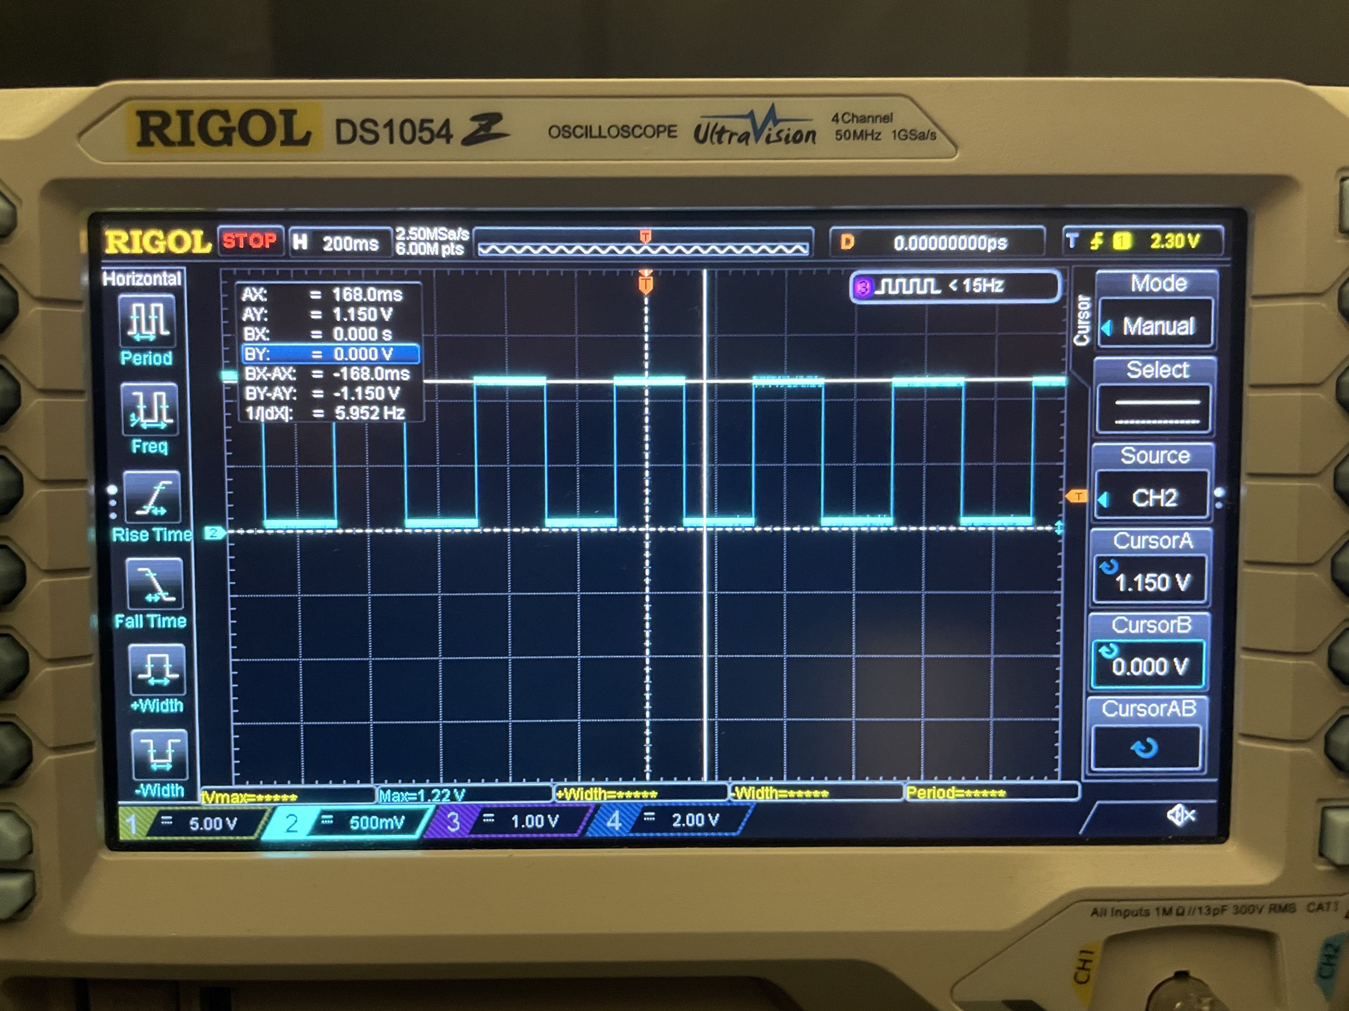
Free Space Optical Communications
Dedicated Optical Transceiver subsystem developed by Craft in partnership with e2e
Enabling high data rate downlinks for growing data heavy Satellite missions
Following CCSDS O3K Standardisation
Reconfigurable Optical FPGA for deployment of alternative protocols
Demonstration of Variable and Adaptable optical communications
Optical Transceiver prototype
OOK Signal generation testing

Slide 8
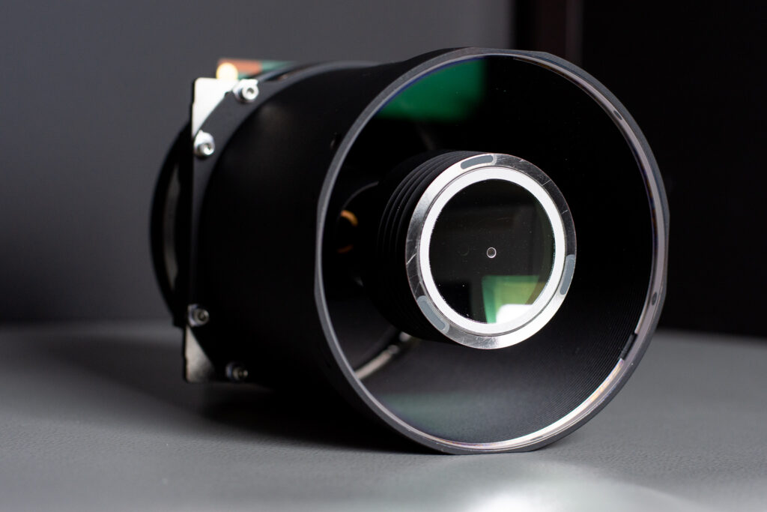
Hyperspectral Imaging
Simera’s Hyperscape100 used for generating hyperspectral data products
Primary Earth Observation payload
32 Bands within the VNIR spectrum
Tuneable data products based on end user needs
Simera xScape100
Processed Hyperspectral Output

Slide 9
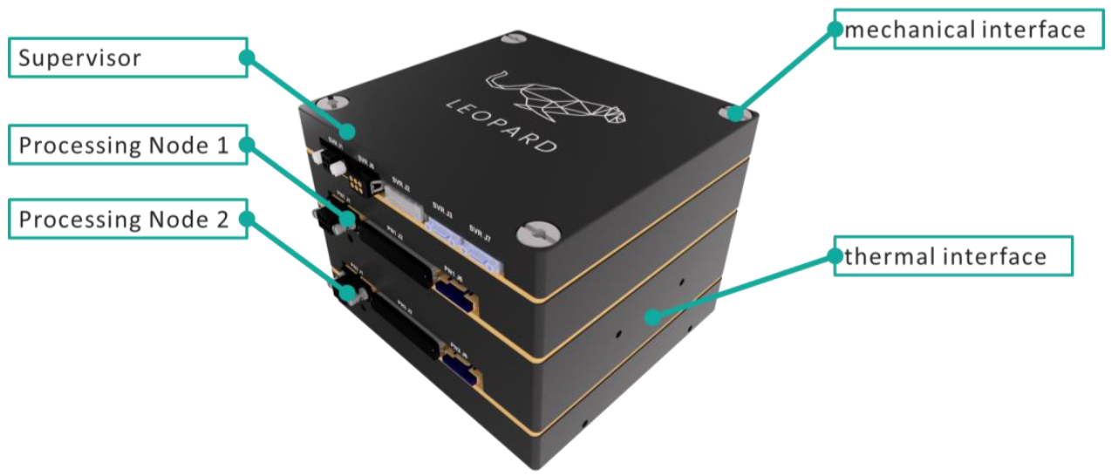
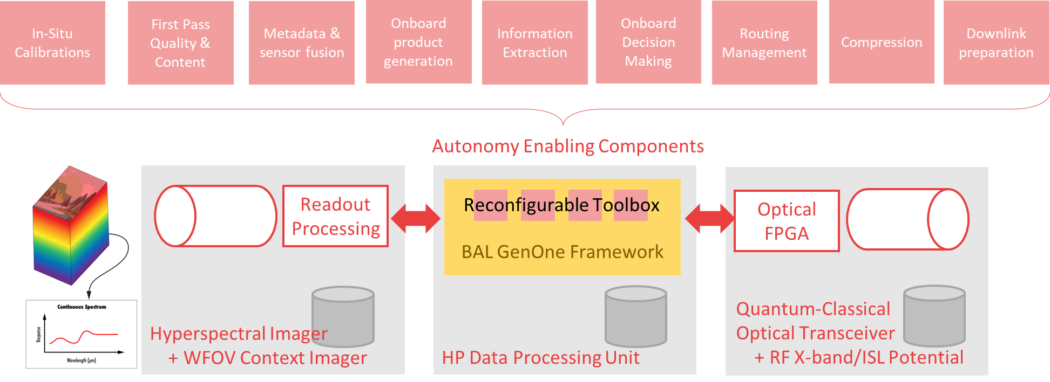
High Performance Data Processing
KP Labs’ Leopard provides high performance data processing within VOLT
Generation of Earth Observation Data products & deployment of Machine Learning algorithms
Processing hyperspectral imagery
Reconfigurable data processing chain
Sandboxing for Ops-Sat experimentation
Data Assurance
KP Labs’ Leopard
Reconfigurable Data Processing Chain

Slide 10
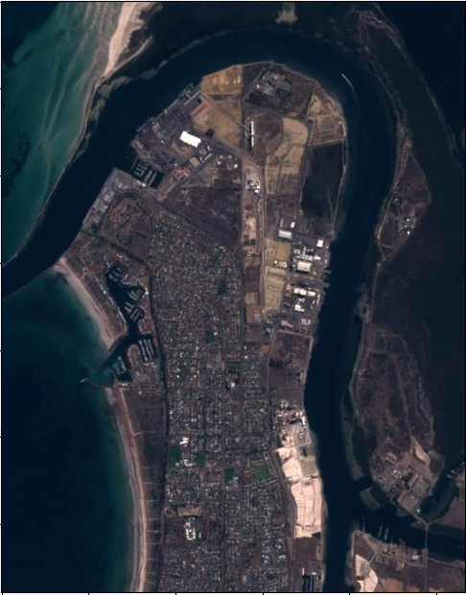
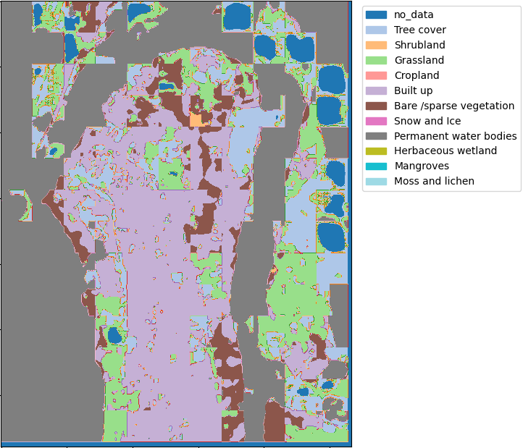
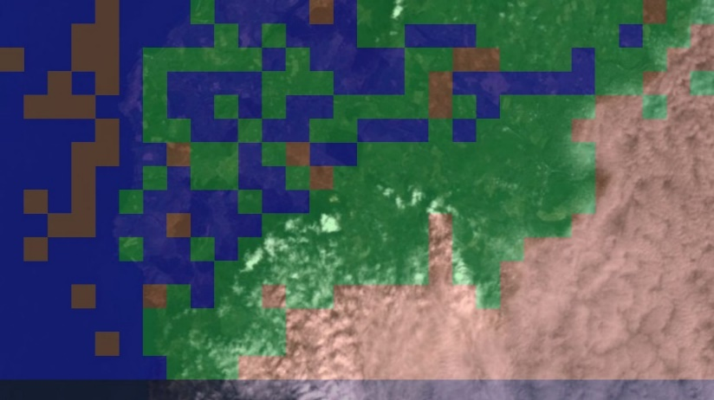
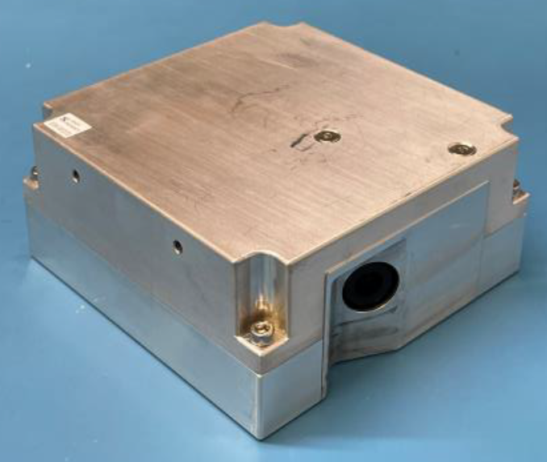
Responsive Operations
Craft Prospect’s Context Imager provides real time decision making
Provides in orbit responsive decision making
Feature detection using Neural Networks
Forward and Nadir pointing enabling reactive decision making
Tasking hyperspectral imager based on areas of interest
Identifying ground station availability through cloud detection
Feature identification and classification
CPL Context Imager
Cloud detection

Slide 11
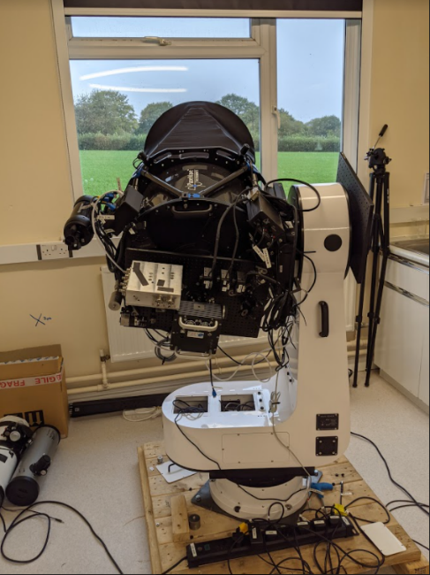
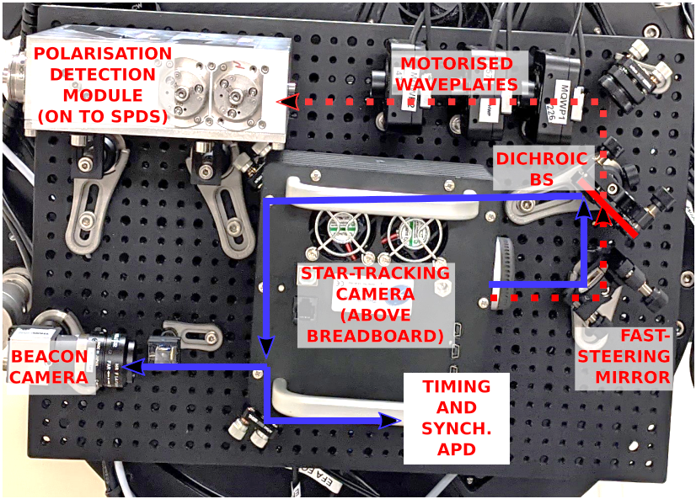
Nomadic Optical Ground Station
OGS developed by Craft Prospect Ltd. and University of Bristol
Portable Optical Ground Station developed for Quantum and Optical Communications
BB84 Quantum Receiver
Optical Transceiver
High precision beam steering module
Beacon system
OGS Optical Breadboard
OGS Prototype

Slide 12
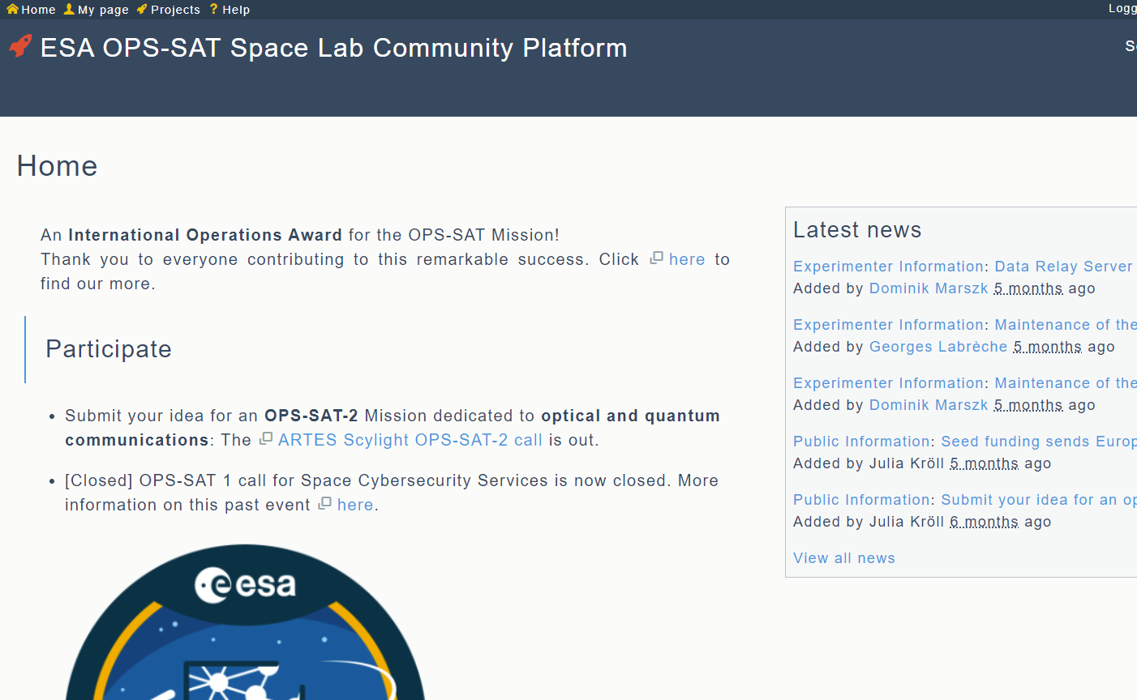
Mission Services
Service | Goals
Augmenting Quantum Key Delivery from Space | Demonstrate enabling technology products and service concepts for quantum key delivery within future classical optical communication networks
Resilience Constellation Satellite System | Demonstrate secure, assured and taskable imaging to the user with onboard processing through optical communication chains for climate resilience
Ops-Sat Experimenter | Provide an in-orbit laboratory for wider community experiments via ESA Ops-Sat (and potential payloads of opportunity)

Slide 13
Ops-Sat Experimenter Service
Purpose:
Enabling in-flight demonstrations of third-party experiments. Providing the hardware and knowledge to validate experiments pre-flight.
Key Features:
End user portal for requesting experiments and access to relevant documentation
In-built API for accessing satellite functions/telemetry
EM satellite for validating experiments on ground
Access to laser communication, quantum communication, and hyperspectral imagery – wide range of potential experiments

Slide 14
Project Schedule
Design
Phase
Build
Phase
Testing &
Integration
Initial
Operations
Experimenter
Online
Launch
Kick - Off
July 2023
Aug 2023
June 2024
Dec 2024
March 2026
June 2026
Dec 2026

Slide 15
VOLT-experimenters@craftprospect.com

